Slide 1
NISSAN COGENT
7026MAA SUPPLY CHAIN MANAGEMENT CW3
- Ninad Killedar (12775008)

Slide 2
Introduction
SUPPLIERS
In 1995, Nissan collaborated with researchers from Cranfield to develop the project Cogent.
This was to develop a co-development sequence between suppliers and the automotive company, Nissan.
In this session, we aim to analyse the key conceptional theories aligned to Early supplier involvement, in New Product Development using the Cogent case.
Development of relationship between the analysed theoretical frameworks of ESI and NPPD in Nissan.
Identification of practical issues in the context the case of Nissan and their ESI strategies in new product development.
Analysis of future trends and anticipated future recommendations that can enhance bussiness performance adapting to change and achieving competitive advantage.
NISSAN
CRANFIELD
The aim of Cogent was to improve the development and performace of the product by getting the Right Quality at the Right Price and at the Right Time. (Nissan Cogent Presentation)
Reduce development time by 30%
Reduce developement cost by 40%
Reduce manifacturing costs by 30%
Source: (Nissan Cogent)

Slide 3
OVERVIEW OF CONCEPT
Start of Production
Co-Development = Achieving mutual goals by creating an understanding between Nissan and suppliers to improve overall performance.
70% of it’s products are in suppliers. (Nissan Cogent)
This is known as a “WIN/WIN” strategy. (Stephanie et al., 2018)
Cogent enables Nissan to use a collaborative, problem solving and intergrative negotiation.
Helps break down barriers which helps achieve targets of right quality, at the right place and right time (Stephanie et al., 2018).
Suppliers
Nissan
Suppliers
Figure 1 Source: (Nissan Cranfield Slides)
Since 70% of their products are their suppliers, their supplier risks and profit remain high.
Nissan works with a handful of suppliers which specialise production to their standards. They have to be closely managed (Cordell & Thompson, 2019).
Ensuring effective relationships can be key to early supplier involvement in new product development (Cordell & Thompson, 2019).
Nissan and their suppliers share benefits and form a co-development relationship.
This enables proactive development in their early stages of production of high value critical items (Cordell & Thompson, 2019).
Since Cogents suppliers add high value to nissan and their service adds signigicant calue they can be classified as “Core” (Fischer, 2017).
Nissan are able to work with suppliers and direct resources effectively to drive performance and achive competetive advantage (Fischer, 2017).
This is achived with collaborative development of high valued suppliers for Nissan (Fischer, 2017).
SUPPLY RISK
Bottleneck
Strategic
Development
Core
ACCOUNT ATTRACTIVENESS
Non-Critical Items (Routine)
Nuisance
Exploitable
Levrerage
PROFIT IMPACT
VALUE TO NISSAN
Figure 2 Source: (Kraljic,1983)
Figure 3 Source: (Fischer, 2017)

Slide 4
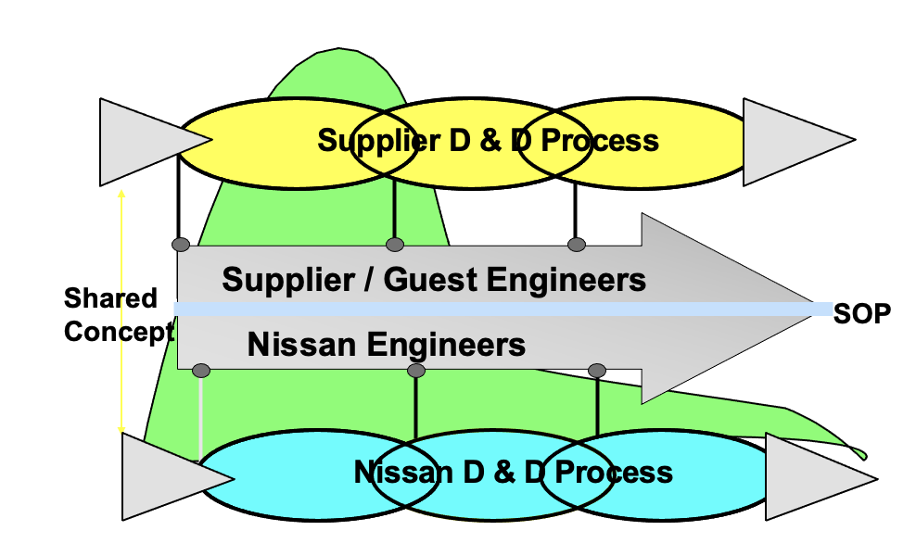
CO-DEVELOPMENT THROUGH PROCESS ALIGNMENT
Co-Development is Nissan’s ability of developing innovative, competitive, consumer focused new car models, with collaborative developent of tier 1 suppliers in the early stages of development of the product life cycle (Lau et al., 2007).
SUPPLIER PERFORMANCE MEASUREMENT (Feedback Loop)
1. Internal standard development
Where do they want to be?
NISSAN
(OEM)
2. Understanding each others processes
Where are we right now?
Identifying strengths and weaknesses.
3. Optimise processes and agree with co-development processes
How do we get there?
Developing process maps.
4. Continuously improve the co-development process
How can they meet Next 21 targets and sustain world class competition?
Implementation of an improvement plan.
Process Alignment is Nissans ability to develop connections in mutual benefits with the design and development processes, ensuring both Nissan and it’s suppliers are effectively working together. (Evans & Jukes , 2000)
TIER 1 SUPPLIER
Process Alignment: Identification of development and improving capabilities.
Joint teamwork between Nissan and supplier engineers and other stakeholders
Figure 4 Process Alignment Model : Adapted from: (Evans & Jukes , 2000)
Nissan
Supplier
Product
Product
Join teamwork between Nissan and Suppliers saves time and cost during the co development phase (Lau et al., 2007).
This is done via Nissan sharing concepts and underline risks involved with both parties.
Helps Alignment of Nissan’s development processes during the early stages in launching new models.
Reduction of resource waste, benefits in lead times and leads to efficient co-development through process alignment (Lau et al., 2007).
Process/Systems
Process/Systems
People & Perceptions
People & Perceptions
Process of
Alignment
Alignment
Continuous
Improvement
Figure 6 Source: (Nissan Cranfield Slides)
Figure 5 Source: (Nissan Cranfield Slides)

Slide 5
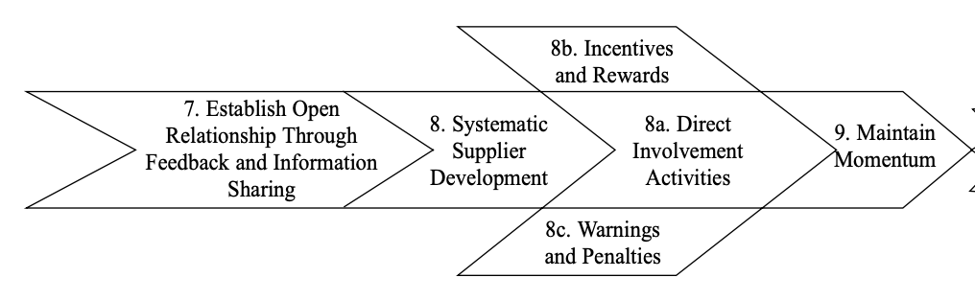
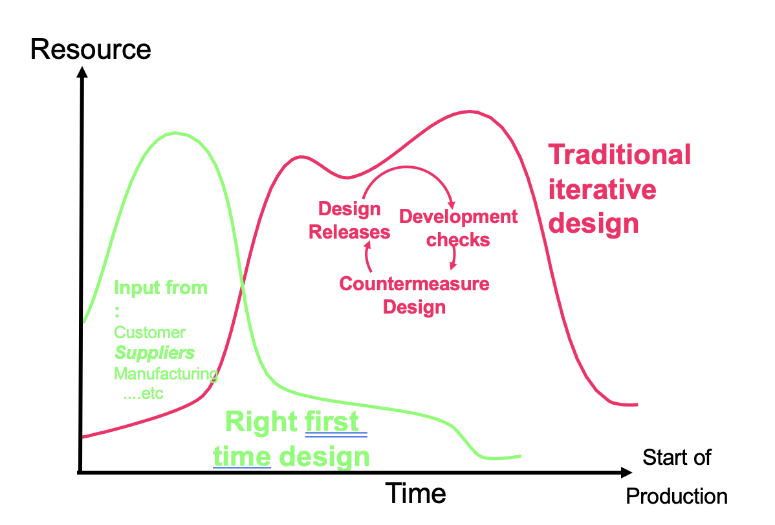
CO-DEVELOPMENT IN NISSAN’S COMPETITIVE PERFORMANCE IN NPD
Cogent aims at involving suppliers near the start in each stage of the New Product Development Process stages.
Releasing design ideas, producing prototypes, and testing prior to production by ESI, helps to achieve the objective of right first time design.
Leads to a reduction of waste, improving quality, saving resources and time by openly sharing costs and technological information early within each stage (Petersen et al., 2004).
Creates a better understanding, drives closer relationships, benefits lead time and improves Nissan’s overall competitive performance. (Petersen et al., 2004).
1: Idea Generation Voice of the Customer.
Process of feedback analysis. What are their next consumer focused product?
Nissan Almera eg, Consumers are looking for reliability and durability and economy.
2. Business Technical Assessment.
Evaluation of technical processes of the new model designs.
Joint advanced technology and improvement planning with third party facilitation.
(Co-Development)
3. Product concept development.
Idea generation using input analysis from suppliers, competitors and product design objectives.
4. Product Engineering design.
Release of design ideas and component development process.
Examples may include design ideas for critical components such as engines, gearboxes, chassis and frames.
5. Prototype building, testing and verification.
Testing and verification of trial parts.
Objective performance measurement. Development checks.
NISSAN’S FIRST-TIER SUPPLIER INTERIGATION POINTS
Start of production
Figure 7 New Product Development Process Model : Adapted from:(Petersen et al., 2004)
RESULTS OF CO-DEVELOPMENT IN NISSAN COGENT
Nissans Aim
103 companies over 130 sites take part in COGENT. Mean improvement now 10.3% pa
Contributes to 80% reduction in design changes after production release.
Figure 8 Supplier Development Model
Stage 3: Proactive supplier development.
7. Proactive development of supplier capabilities.
8. Supplier improvement projects Eg, Process mapping, alongside incentives, drives supplier performance. (Krause & Handfield, 1999).
9. Suppliers can incorporate constant improvement based on information and feedback recieved from the OEM (Krause & Handfield, 1999).
This makes suppliers self reliant and continuous improvement can result to a drive for Nissan’s Competitive advantage (Krause & Handfield, 1999).
Adapted from: (Krause & Handfield, 1999)
Very low rate of supplier improvement in development 0.6% pa
1992
1997
Source: (Nissan Cranfield Slides)

Slide 6
ESI with collaborative practice
Generating 30% reduction in D&D cost & time with improved quality. Ex. Nissan Almera
EARLY INVOLVEMENT OF NISSAN SUPPLIERS
With Nissan engineers & NETC
Supplier optimization
Led to Supplier Performance evaluation system/model
With Cranfield University
EARY SUPPLY INVOLVEMENT (ESI)- A strategy to improve the technical, designing&assembling, testing, and machining capabilities of the supplier during NPPD. (Monczka et al., 1995)
Relevance of ESI :
1) Suppliers can
i. shed light on the production steps for purchased materials.
ii. have incharge of the whole technical development and design of procured components.
2) Reduce development time and cost during design & engineering phases of NPD.
(Monczka et al., 1995)
INCREASING SUPPLIER RESPONSIBILITY
NONE | White Box | Gray Box | Black Box
There is no interaction with or involvement of supplier. | Parameters and demands are discussed with suppliers, but the purchasing business makes all design and specification decisions. | The buyer and supplier engage in a collaborative development effort (informal or formal). It may involve sharing of technological data as well as mutual decision-making over design criteria. | The buying firm just reviews and approves the specification of purchased parts. They just convey the customer’s requirements to the supplier before giving them practically whole responsibility for the product.
Development of Long-term supplier relationship: represents a joint product development relationship with shared development costs and designs to form closer buyer-supplier relationship.(Handfield et al., 2011)
Meetings & workshops with MD’S of suppliers.
Supply base reduction (89). Improved workflow, lead times, and achieved right-first-time design
NX ‘96
NEXT 21
(Q-C-D-D-M)
Outcomes of implementing ESI during COGENT
Fig 1. Supplier Integration Spectrum (Petersen et al., 2004)
“Japanese automakers allocated the suppliers the responsibility of planning, executing, ensuring the quality and design of new components.” (Loch & Kavadias, 2007)

Slide 7
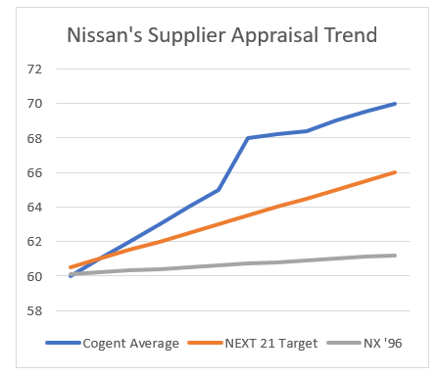
SUPPLIER DEVELOPMENT (Q - C - D - D - M )
“Nissan uses its Q C D D M approach (Quality, Cost, Delivery, Development and Management)is used daily, weekly, monthly or yearly to assess current performance, spot problems faced, encourage suppliers to take action, and ultimately decide if they'll be hired to work on new models in future.”(Burnes & New, 1996)
“A firm that is able to accomplish approaches to supplier contributions and capability improvements can achieve competitive advantage by forming a world-class supply base that leads to organizational success.” (Monczka et al., 1995)
“Nissan Motors in the UK has been one of the leading advocates of the co-development concept.” (Christopher et al., 2011)
Measurables | Q | C | D | M
Drawings
Trial Parts
Tests
1
2
2
2
Fig 3.Nissan Supplier Appraisal Trend (Nissan COGENT, 2013)
2
3
2
2
Supplier Performance Improvement through QCDDM approach :
NX ‘96 : 1%
NEXT 21 Target : 5% (demanded)
COGENT Avg : 11% (achieved)
2
3
2
2
1 - Priority 1 2 - Priority 2 3 - Priority 3

Slide 8
PRACTICAL PROBLEMS IN EARLY SUPPLIER INVOLVEMENT
NISSAN
Supplier Trust/dependency
Trust
Information leaking from supplier side
Supplier capacity constraints
Mutual trust and communication(Taneli Eisto et al., 2010).
Chances of increase in cost and time for both the product and the development and product performance difficulties (Birou and Fawcett,1994).
Lack of sureness of the outcome (Eisenhardt,1989).
Inefficient internal procedures driving up costs (Zsidisin & Smith, 2005).
Less supplier involvement (Bidault et al.,1998).
Legal liabilities (Zsidisin & Smith, 2005).
Supplier capacity constraints (Zsidisin & Smith, 2005).
Problem handling the product design changes if needed (Zsidisin & Smith, 2005).
Leaking of information (Wynstra, 1998).
The policy guidelines lack precision and contain many contradictions (McIvor and Humphreys, 2004).
Fig 1: Problems in ESI
(Zsidisin & Smith, 2005)

Slide 9
PRATICAL ISSUES IN NEW PRODUCT DEVELOPMENT
Issues faced by Nissan in NPD
Asymmetrical power relationship between Nissan and its suppliers leading to supplier’s knowledge exploitation
Disagreements among Nissan’s development team
Distinct perceptions of Nissan’s suppliers on how to deliver new components
Chances of leakage of important information by suppliers to Nissan’s competitors
Initial mis understanding of the design tools by Nissan’s suppliers
Asymmetrical relationships – exploits supplier knowledge (Flankegård et al., 2021).
Tools/technology – initial misunderstanding on how to use design tools by suppliers (Flankegård et al., 2021).
Disagreements among the integrated product development team’s members (Chavhan, 2012).
Different suppliers had distinct perceptions on how they were expected to deliver new components (LaBahn & Krapfel, 2000).
Leakage of information – possibility of leakage of important information to the competitors (Taneli Eisto et al., 2010).

Slide 10
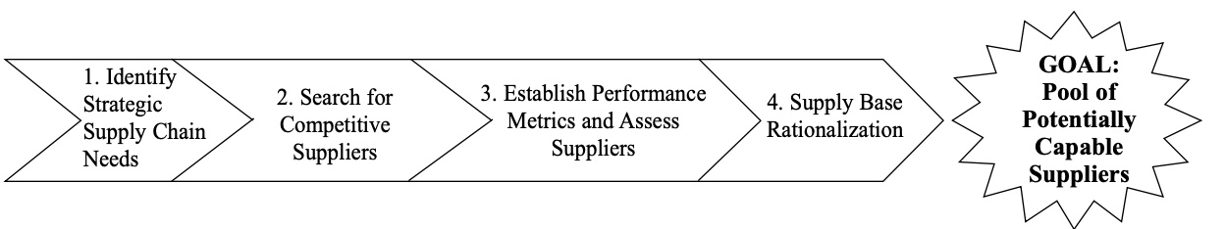
FUTURE TRENDS AND RECOMMENDATIONS
Technology advancements in systems digitalization and product life cycle management systems (PLM’s).
Setting up performance enhancements with second and third-tier suppliers which would assist Nissan in the future in achieving a globally coordinated supplier network.
Establishing an Approach of EDI ( Electronic data interchange) (Monczka et al., 1995)
Involvement of ESI in NISSAN can reduce design failure in the future and has more time in creating new ideas.
Stage 1 Crouse Framework Source: (Krause & Handfield, 1999)
Use the Krause framework stage 1 to identify potential, capable suppliers to identify digitalisation and automation methods.
These methods can help digitalize early supplier involvement and performance management systems in early product development processes in the PLM.
Siemens, Oracle and other software providers could be potential suppliers.

Slide 11
KEY LEARNING POINTS
Identification of Nissan buyer supplier “win/win” relationship strategy within early supplier interrogation of new product development processes.
Analysis of key suppliers segmentaion using Khraljic in relation to risk and and profit impact to the OEM (Nissan) as well as their supplier preference with those that are involved in the early stages of new product design and development.
Understanding of how co-development is achieved using the process alignment model in early supplier involvement.
Analysis of how co-development can be used during the new product development process model, using supplier development stage 3 from Krause framework to achieve competitive advantage within the early stages of NPPD.
Able to identify practical issues in early supplier involvement process and handle ESI problems.
Able to identify the practical issues that Nissan likely faced during the new process development
Able to categorize of Nissan's NEXT 21 in to supplier integration spectrum
How Nissan's QCDDM approach ensured performance development and continuous improvement of suppliers

Slide 12
References
Bidault, F., C. Despres and C. Butler. New Product Development and Early Supplier Involvement (ESI): The Drivers of ESI Adoption,”International Journal of Technology Management, ( 15: 1/2), 1998, pp. 49- 69
Birou, L.M. and S.E. Fawcett. Supplier Involvement in Integrated Product Development: A Comparison of US and European practices,”International Journal of Physical Distribution and Logistics Management, ( 24: 5), 1994, pp. 4- 14
Burnes, B. and New, S. (1996) “Understanding Supply Chain Improvement,” European Journal of Purchasing &amp; Supply Management, 2(1), p. 26. Available at: https://doi.org/10.1016/0969-7012(95)00018-6.
Chavhan, R. (2012). Supplier Development: Theories and Practices. IOSR Journal of Mechanical and Civil Engineering, 3(3), 37–51. https://doi.org/10.9790/1684-0333751
Chavhan, R. (2012). Supplier Development: Theories and Practices. IOSR Journal of Mechanical and Civil Engineering, 3(3), 37–51. https://doi.org/10.9790/1684-0333751
Christopher, M. (2011) in Logistics and Supply Chain Management. 4th edn. Pearson, pp. 215–217.
Cordell, A., & Thompson, I. (2019). Section 3 Relationships . In The Procurement Models Handbook (pp. 67–80). essay, Routledge.
Cranfield , N. (n.d.). Nissan European Technology Center .
Evans, S., & Jukes , S. (2000). Improving co‐development through process alignment. International Journal of Operations & Production Management, 20(8), 970–989. https://doi.org/10.1108
Fischer, M. (2017). (rep.). Antecedents and Benefits of Supplier Satisfaction and the Influence of Segmentation and Status on Buyer-Supplier Relationships: A Multi-Perspective Case Study of Company X and Four of its Suppliers (pp. 8–14). Netherlands, Enschede: University of Twente, Faculty of Behavioural, Management and Social science.
Flankegård, F., Granlund, A., & Johansson, G. (2021). Supplier involvement in product development: Challenges and mitigating mechanisms from a supplier perspective. Journal of Engineering and Technology Management, 60, 101628. https://doi.org/10.1016/j.jengtecman.2021.101628
Handfield, R.B. et al. (2011) “Chapter 6 : Supply management and commodity strategy development,” in Sourcing and Supply Chain Management. Andover: South-Western Cengage Learning, p. 220.
Krause, D. R., & Handfield, R. B. (1999). Developing a world-class supply base. Center for Advanced Purchasing Studies.
LaBahn, D. W., & Krapfel, R. (2000). Early supplier involvement in customer new product development. Journal of Business Research, 47(3), 173-190. https://doi.org/10.1016/s0148-2963(98)00066-6
Lau, A. K. W., Yam, R. C. M., & Tang, E. P. Y. (2007). Supply chain product co‐development, product modularity and product performance. Industrial Management & Data Systems, 107(7), 1036–1065. https://doi.org/10.1108/02635570710816739
Loch, C. and Kavadias, S. (2007) “Chapter 9. Modularity and supplier involvement in product development,” in Handbook of New Product Development Management. 1st edn. London: Routledge, p. 221.

Slide 13
McIvor, R. and P. Humphreys. Early Supplier Involvement in the Design Process: Lessons from the Electronics Industry,”Omega, ( 32: 3), 2004, pp. 179- 199.
Monczka, R.M. and Trent, R.J. (1995) in Purchasing and sourcing strategy: Trends and implications. Tempe, AZ: Center for Advanced Purchasing Studies, p. 55.
Monczka, R.M., Handfield, R.B., Scannell, T.V., Ragatz, G.L. and Frayer, D.J. (2000) New Product Development: Strategies for Supplier Integration, edn. Milwaukee, Wisconsin: American Society for Quality, Quality Press.
Petersen, K. J., Handfield, R. B., & Ragatz, G. L. (2004). Supplier integration into new product development: Coordinating Product, process and supply chain design. Journal of Operations Management, 23(3-4), 371–388. https://doi.org/10.1016/j.jom.2004.07.009
Petersen, K.J., Handfield, R.B. and Ragatz, G.L. (2004) “Supplier integration into new product development: Coordinating Product, process and supply chain design,” Journal of Operations Management, 23(3-4), pp. 371–388. Available at: https://doi.org/10.1016/j.jom.2004.07.009.
Stephanie , T., Jacqueline, E., David , S., & Denton , T. (2018). A comparative assessment of win-win and win-lose negotiation strategy use on supply chain relational outcomes. International Journal of Logistics Management, 191–215. https://doi.org/10.1108
Taneli Eisto, Venlakaisa Hölttä, Katrine Mahlamäki, Janne Kollanus, & Marko Nieminen. (2010). Early Supplier Involvement in New Product Development: A Casting-Network Collaboration Model.
Zsidisin, G. A., & Smith, M. E. (2005). Managing Supply Risk with Early Supplier Involvement: A Case Study and Research Propositions. The Journal of Supply Chain Management, 41(4), 44–57. https://doi.org/10.1111/j.1745-493x.2005.04104005.x

